Slide 1

An Automated COVID-19 SOPs Monitoring And Management System
GSN: FALL 21-18
Presented by:
Maaheen Yasin (L18-1267)
Inbisat Mudassar Dar (L18-1283)
Ahmad Tameem Kamal (L18-1358)
Advisor: Mr. Hamza Yousuf
Client: Dr. Omer Saleem
Evaluation Committee:
Ms. Shazia Haque
Dr. Omer Saleem

Slide 2

Comparison of Temperature Sensors
About MLX90614
Haar Cascade OpenCV
Data Set Training
Detection through MediaPipe
Conclusion
CONTENTS

Slide 3

Comparison of Different Temperature Sensors
Type | Voltage Range (V) | Temperature Range in ˚C | Price Range in Rs | Compatible with Raspberry Pi | Other Features
DHT11 | 3-5.5 | 0 - 50 | 250-256 | YES | Temperature & Humidity sensor ADC
LM35DZ | 4-30 | -55 - 150 | 250-300 | YES
DHT22 | 3-6 | -40 - 80 |  | YES | Temperature & Humidity sensor 2 second sampling period
TMP36 | 2.7 – 5.5 | -40 - 125 | 2900-2932 | YES | Analog temperature sensor
MLX90614 | 8-16 | -70 - 380 | 2600-2700 | YES | 17 bit ADC Easy to integrate IR temperature sensor Powerful DSP & high accuracy
MLX90641 MLX90640 |  | -40 - 300 | 25000-28000 | YES | IR thermal sensor array 32x24 pixels thermal camera

Slide 4
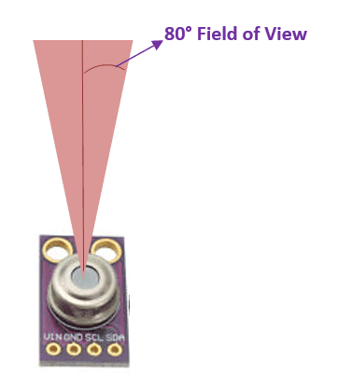
About MLX90614
Non-Contact Temperature Sensor which utilizes IR to calculate the temperature of an object
Two devices that are embedded on it are infrared thermopile detector and signal condition DSP device.
It measures how much IR energy is emitted by a target object and converts it into temperature value using a 17-bit built in ADC.
The value of sensing distance is given by the term Field of View (FOV), for our sensor the field of view is about 80°.
For every 1cm we move away from the object the sensing area grows by 2cm.

Slide 5
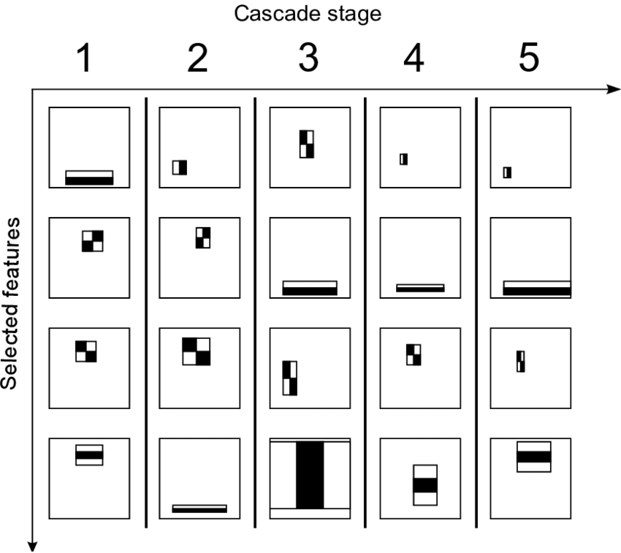
Haar Cascade Algorithm Working
Machine learning approach and sliding window
Detection by Haar Like features,
which compare brightness or intensity
of pixels, edges
This algorithm is not accurate and
false detections are common.
First Stage is Classifier Training and
and second is detection

Slide 6

Training Classifier
Collecting Data:
Haar Cascade required Negative and Positive Samples
Kaggle and ImageNet
Processing/Classifying Dataset:
Data Augmentation:
Cropping, Resizing, Labelling, Annotation
OpenCV prefer XML file format
Selecting Method for training: Linear Binary Pattern or Histograms
Training Classifier
Saving trained classifier

Slide 7
Detection Stage
Image Input: Input image frame, apply image processing techniques to resize or to decrease noise etc.
Image Classification: Predict the class score of each window region
Image Localization: Identifying the location of one or more object and drawing the bounding boxes on region of interests with high prediction scores.
Image Captioning: Add the text on the image
Parameters: Adjust scaleFactor , minNeighbors, minSize

Slide 8
Results
The average prediction score of With Mask (Positive classifier) is 45% and (Without Mask) Negative is 0 % with custom classifier trained with 1000 images
The average speed on CPU is 2 FPS
The results can be improve by retraining data, using different dataset and tuning parameters.
Due to slow speed and accuracy issues it cannot be used for direct image input, instead we can used mediapipe which can simplify and crop image to extract region of interest. This region of interest can be used in HaarCascade for object detection

Slide 9
MediaPipe Face Detection
Mediapipe is the open source cross platform library which provide computer vision algorithms for object detection and tracking
It is designed by google specifically for mobile applications and devices without GPU.
Mediapipe Face detector uses BlazeFace, which is the modified version of Single Shot Detector (SSD, with MobileNet.
In real-time, very precise and does not required any GPU

Slide 10
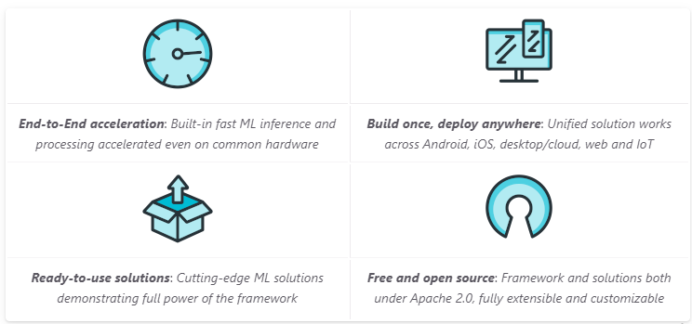
MediaPipe

Slide 11
Conclusion
The average accuracy of mediapipe face detector is 95% and average speed if 40 FPS on CPU
Thus, by using mediapipe with openCV haar cascade the overall system efficiency significantly increases and also minimize the draw backs of haar cascade detector
We would be using MLX90614 for contact-less temperature sensing at a distance of 2cm

Slide 12


